Slide 1
Easy Speech
Created by:
Pontus Olsson Martin Eriksson Jonas Karlsson

Slide 2
Topics covered
Introduction
Aim and purpose
Method and implementation
Results from this project
Conclusion
Further work

Slide 3
The starting idea
A voice activated robot
Voice recognition in C
Robot recognizes different users
Gives a voice feedback depending on user

Slide 4
The actual idea
Voice controlled robot
Android(java) instead of C
Lit lights using voice commands
Store commands in database

Slide 5
Hardware and software used
Bluetooth unit
Arduino atmega328p
Android studio
Arduino playground
SQLite

Slide 6
Aim and purpose
Voice recognition application
Store commands
Return commands in text

Slide 7
Research questions
How can we make voice recgonition a more reliable input?
How can voice recognition be used to improve the quality of life?

Slide 8
Method and implementation
Android
Bluetooth connection
SQLite
Arduino

Slide 9
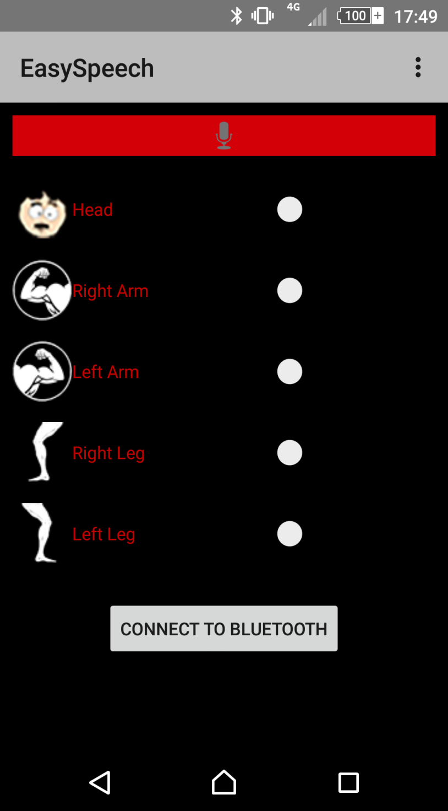
Android
This is the EasySpeech app
Speech to text
On activity results
Print command
Switch
Bluetooth

Slide 10
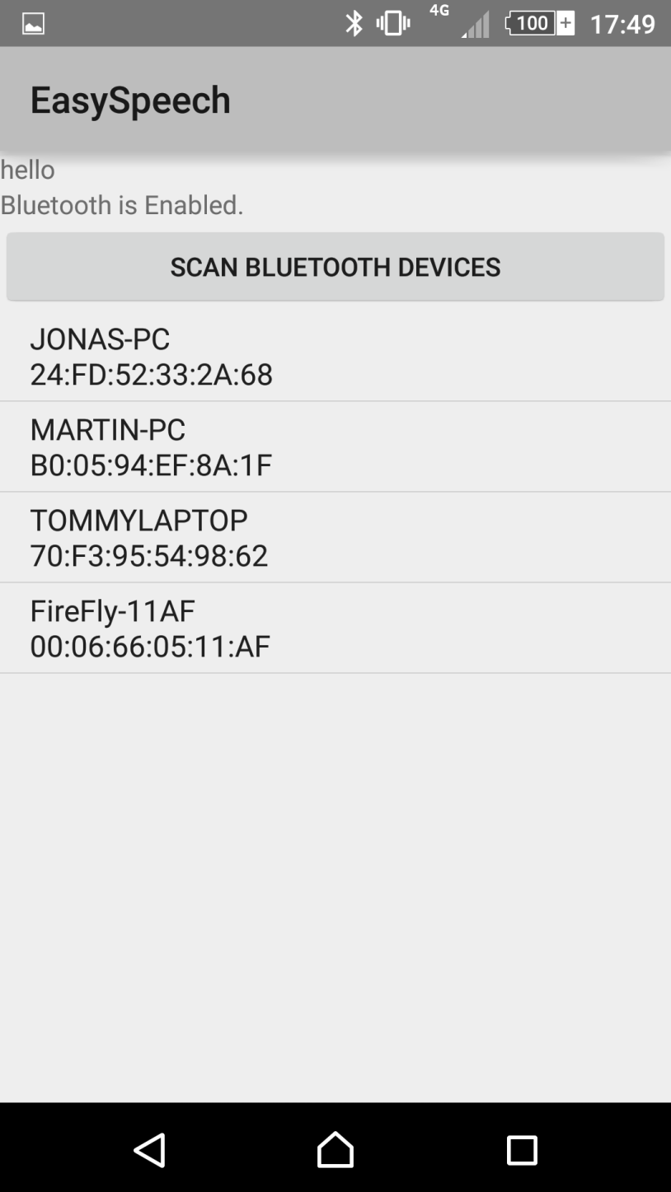
Bluetooth
Bluetooth devices
Our bluetooth module

Slide 11
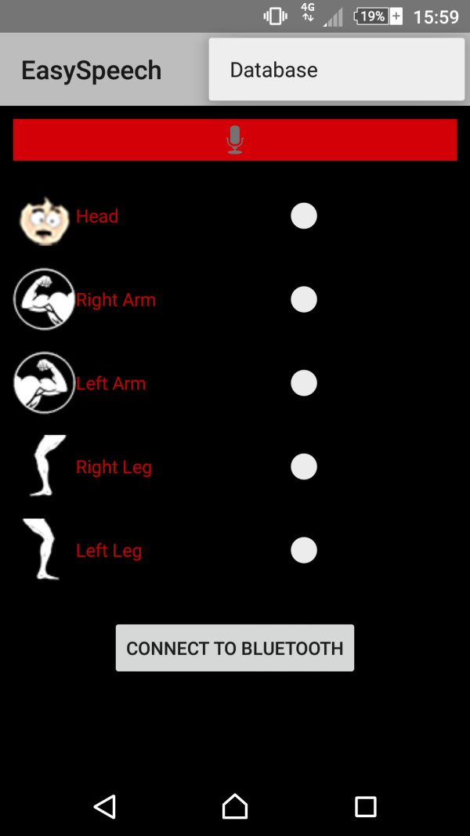
SQlite Database
Main menu

Slide 12
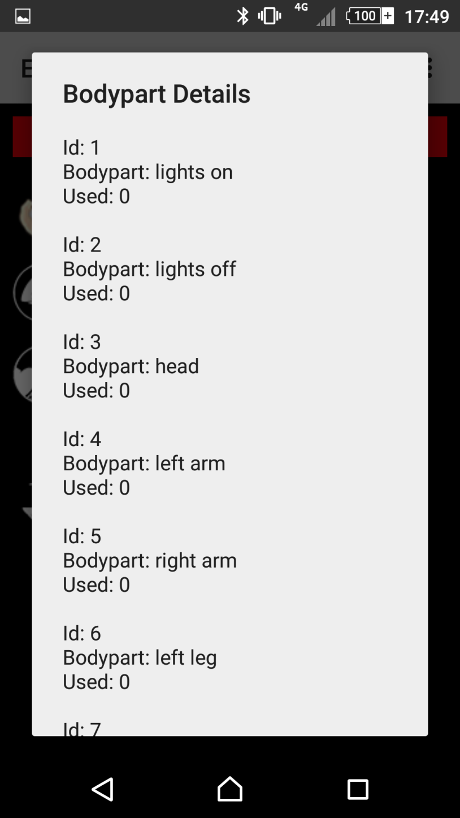
SQlite Database
Command history

Slide 13
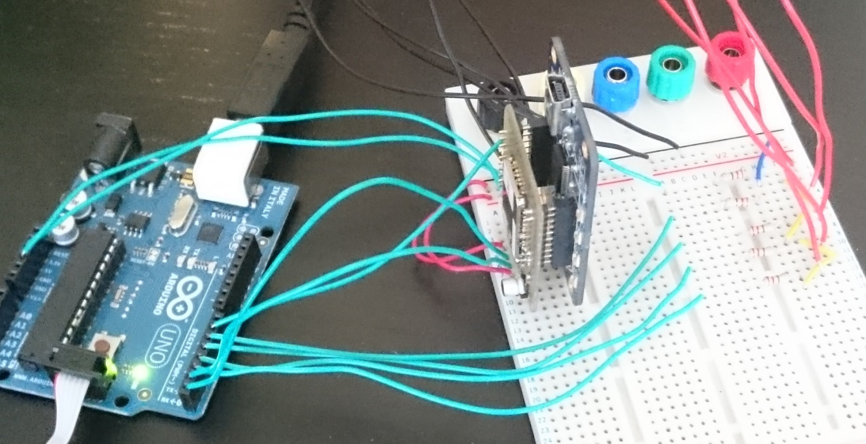
Arduino
Connection
Arduino playground

Slide 14
Results from this project
The actuall results
How did we get there?
XP
Black box – White box
GitHub
Problems on the way
How did we solve the probelms
Velocity 0.8 with 259 working hours

Slide 15
Results
Movie time!

Slide 16
Conclusion
Can we improve quality of normal life?
Where?
Is voice recognition a reliable input?
Why?

Slide 17
Further work
More functions
Implementation in real life
Why did we not do it?

Slide 18
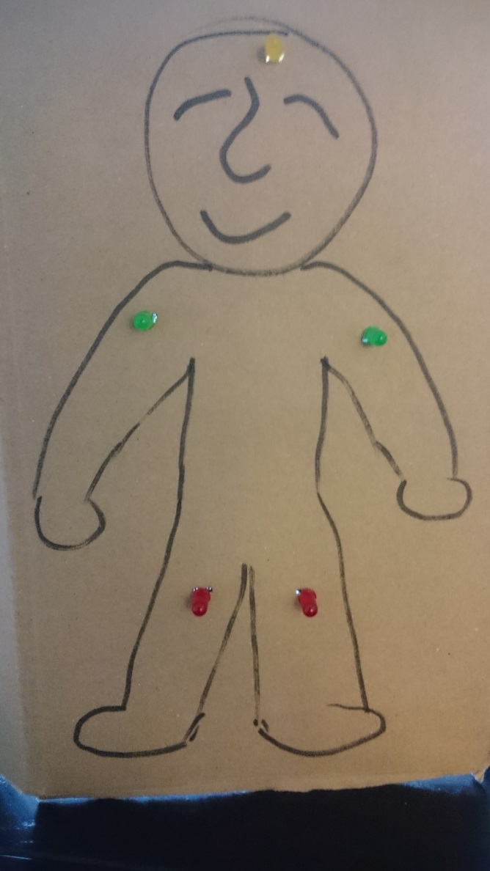
Thanks for listening!

Slide 19
Questions and feedback!

